Slide 1
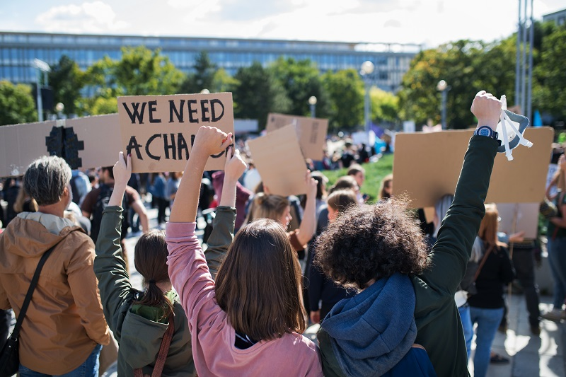
RIGHT TO PROTEST
Notes:
What is a protest?
A protest is a public expression of objection, disapproval, or dissent towards an idea or action.

Slide 2
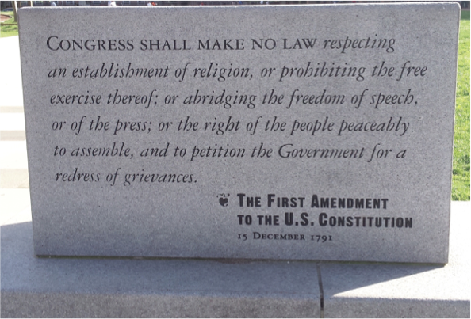
The First Amendment of the Constitution guarantees citizens five specific rights.

Slide 3
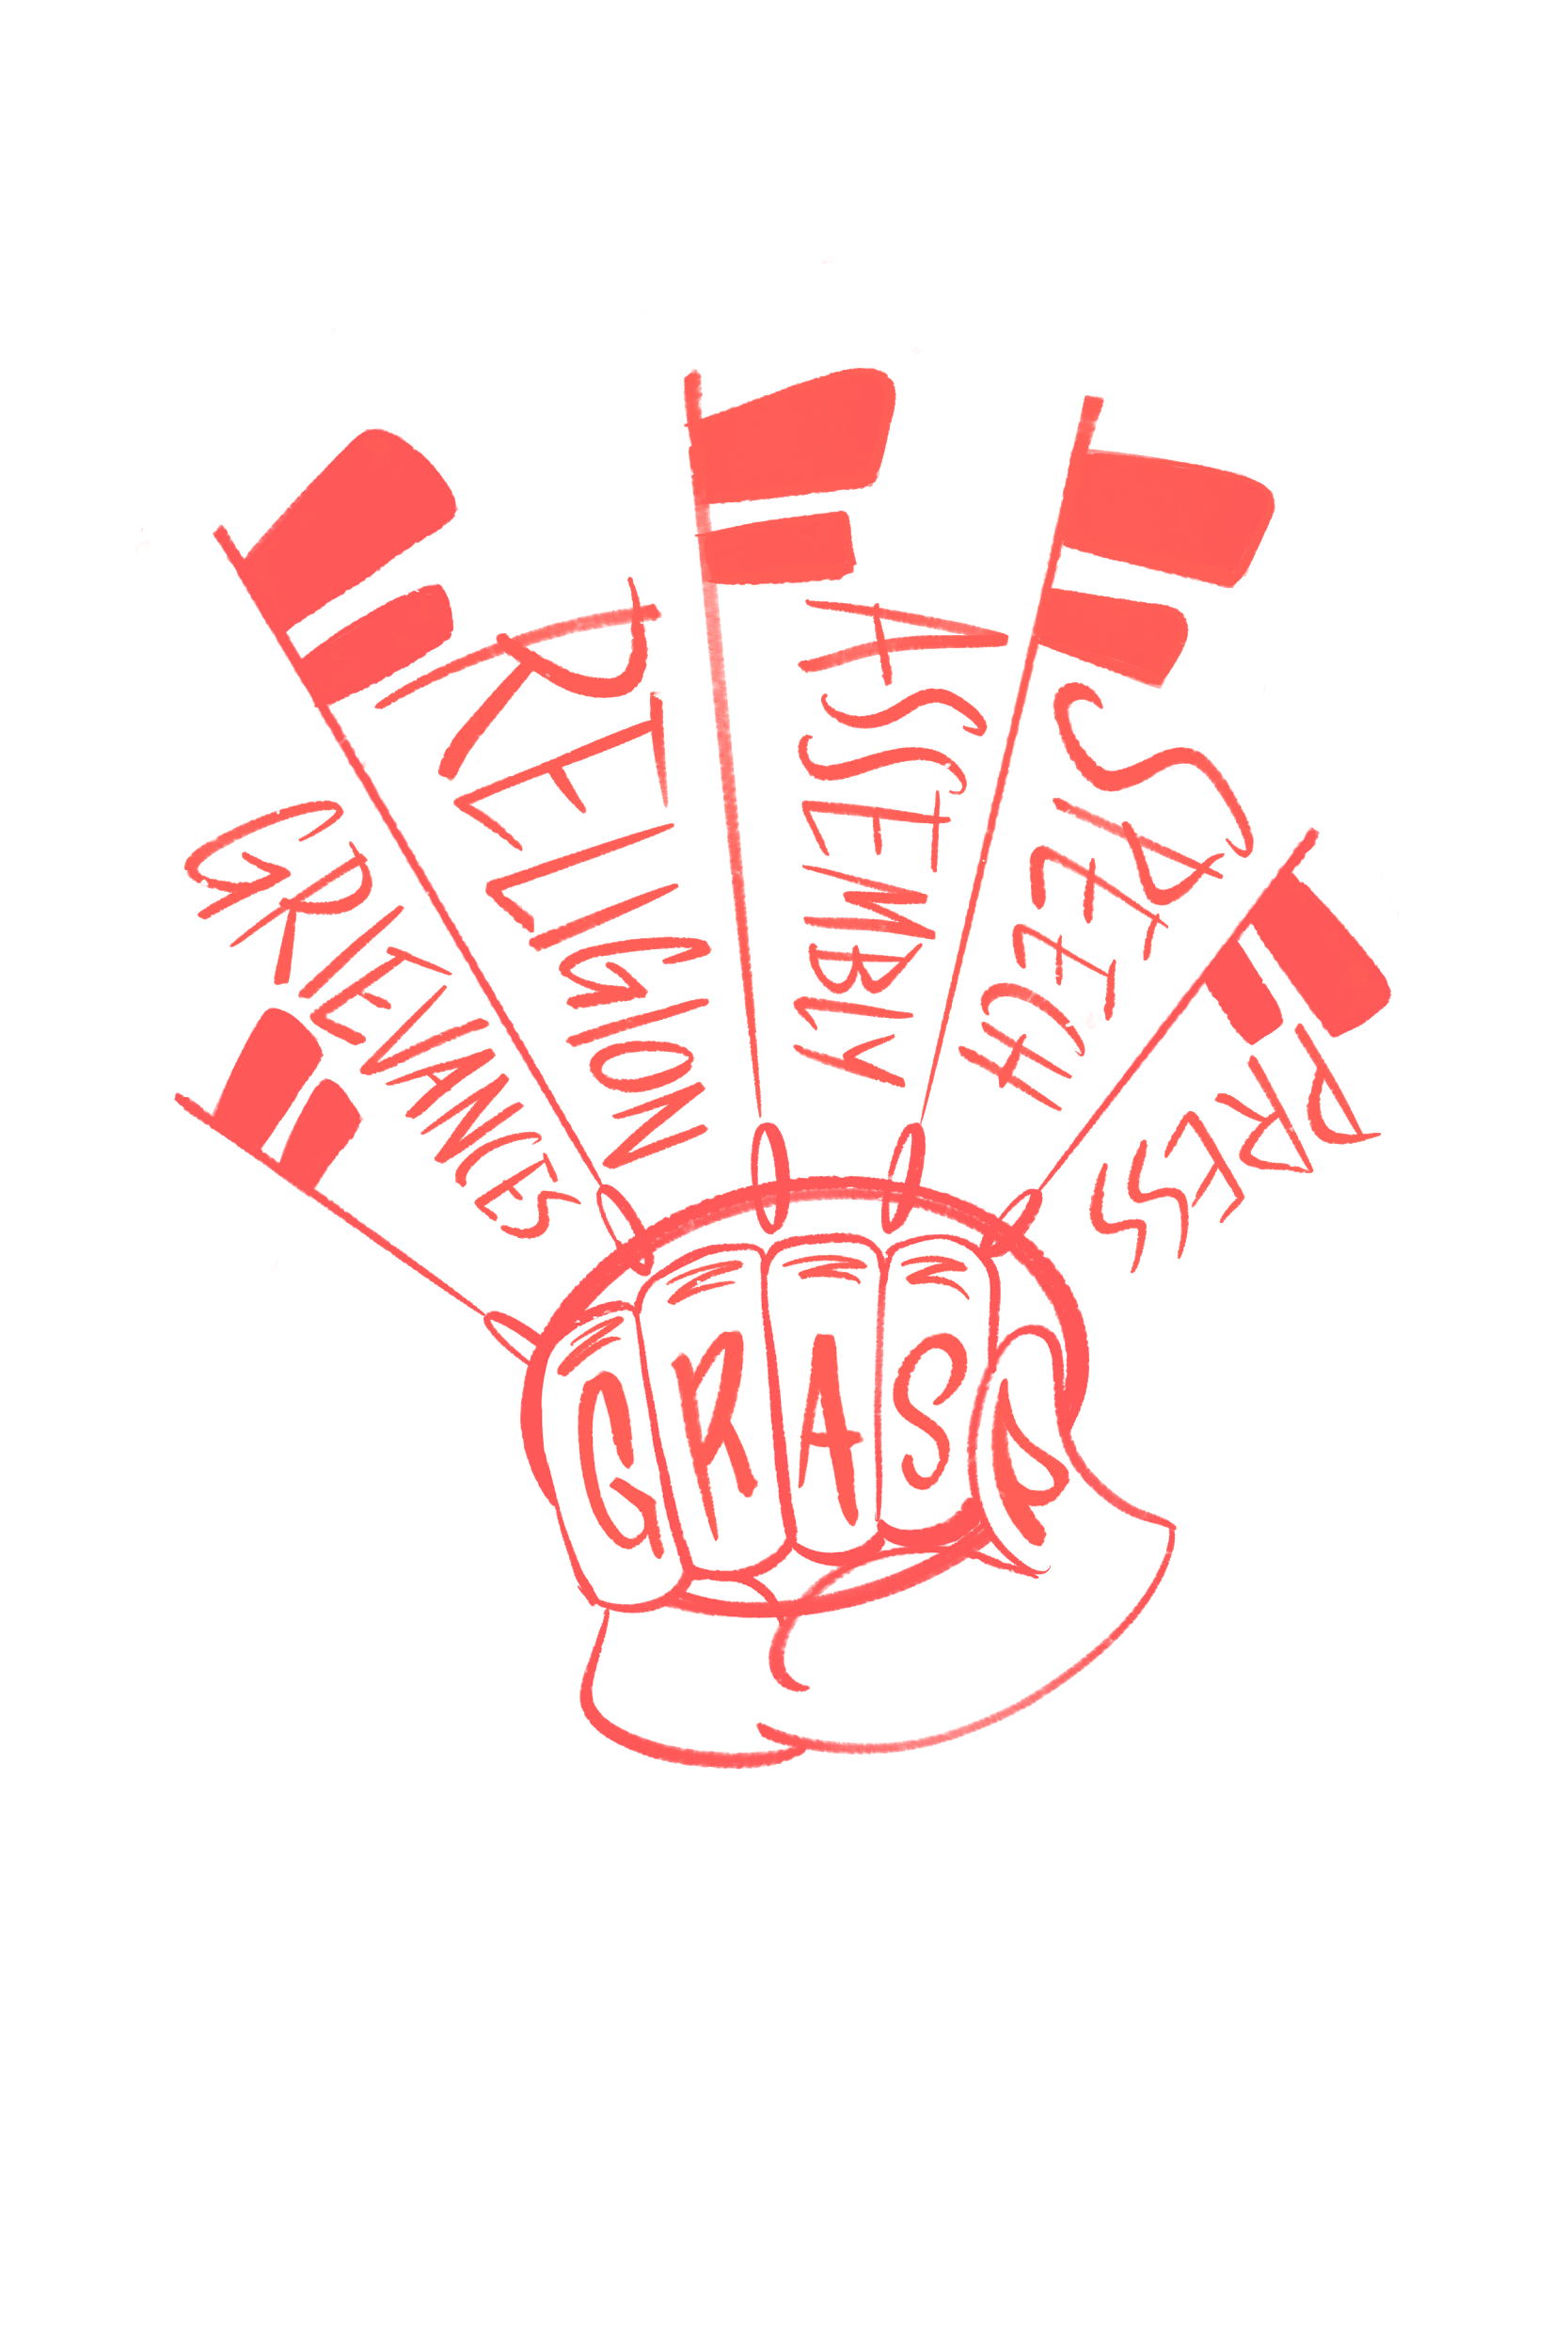
First Amendment guarantees
Freedom of religion
2. Freedom of speech
3. Freedom of the press
4. Right to assemble
5. Right to petition the government

Slide 4
The right to protest includes three of the five First Amendment rights.
Right to assemble
Why is freedom of assembly important?
How has it been used?
Right to petition the government
Why is freedom to petition important?
How has it been used?
Freedom of speech
How is freedom of speech connected to the right to protest?
Notes:
What is a petition?
A petition is a request to do something, most commonly addressed to a government official or public entity and signed by many people.

Slide 5
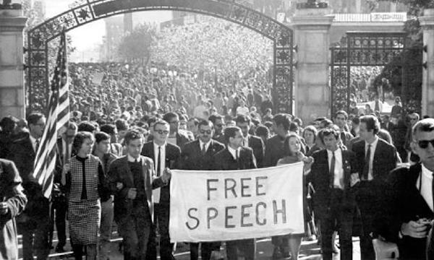
Freedom of speech is closely tied with the right to protest.
If you are protesting, you are using your free speech rights to communicate a message to other people.

Slide 6
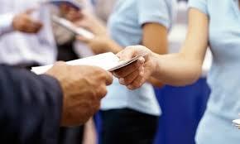
Legal forms of protest
Speaking out
Picketing
Marches
Hosting events
Gatherings
Counter-demonstrations
Distributing leaflets/literature
Setting up a table or news rack to display materials
Notes:
What is picketing?
Picketing is a form of protest in which people congregate outside of a location where an event is taking place.
What is a counter-demonstration?
A counter-demonstration is a public demonstration organized in order to express opposition to the aims of another demonstration, often held in close proximity to an ideologically opposite protest or demonstration

Slide 7
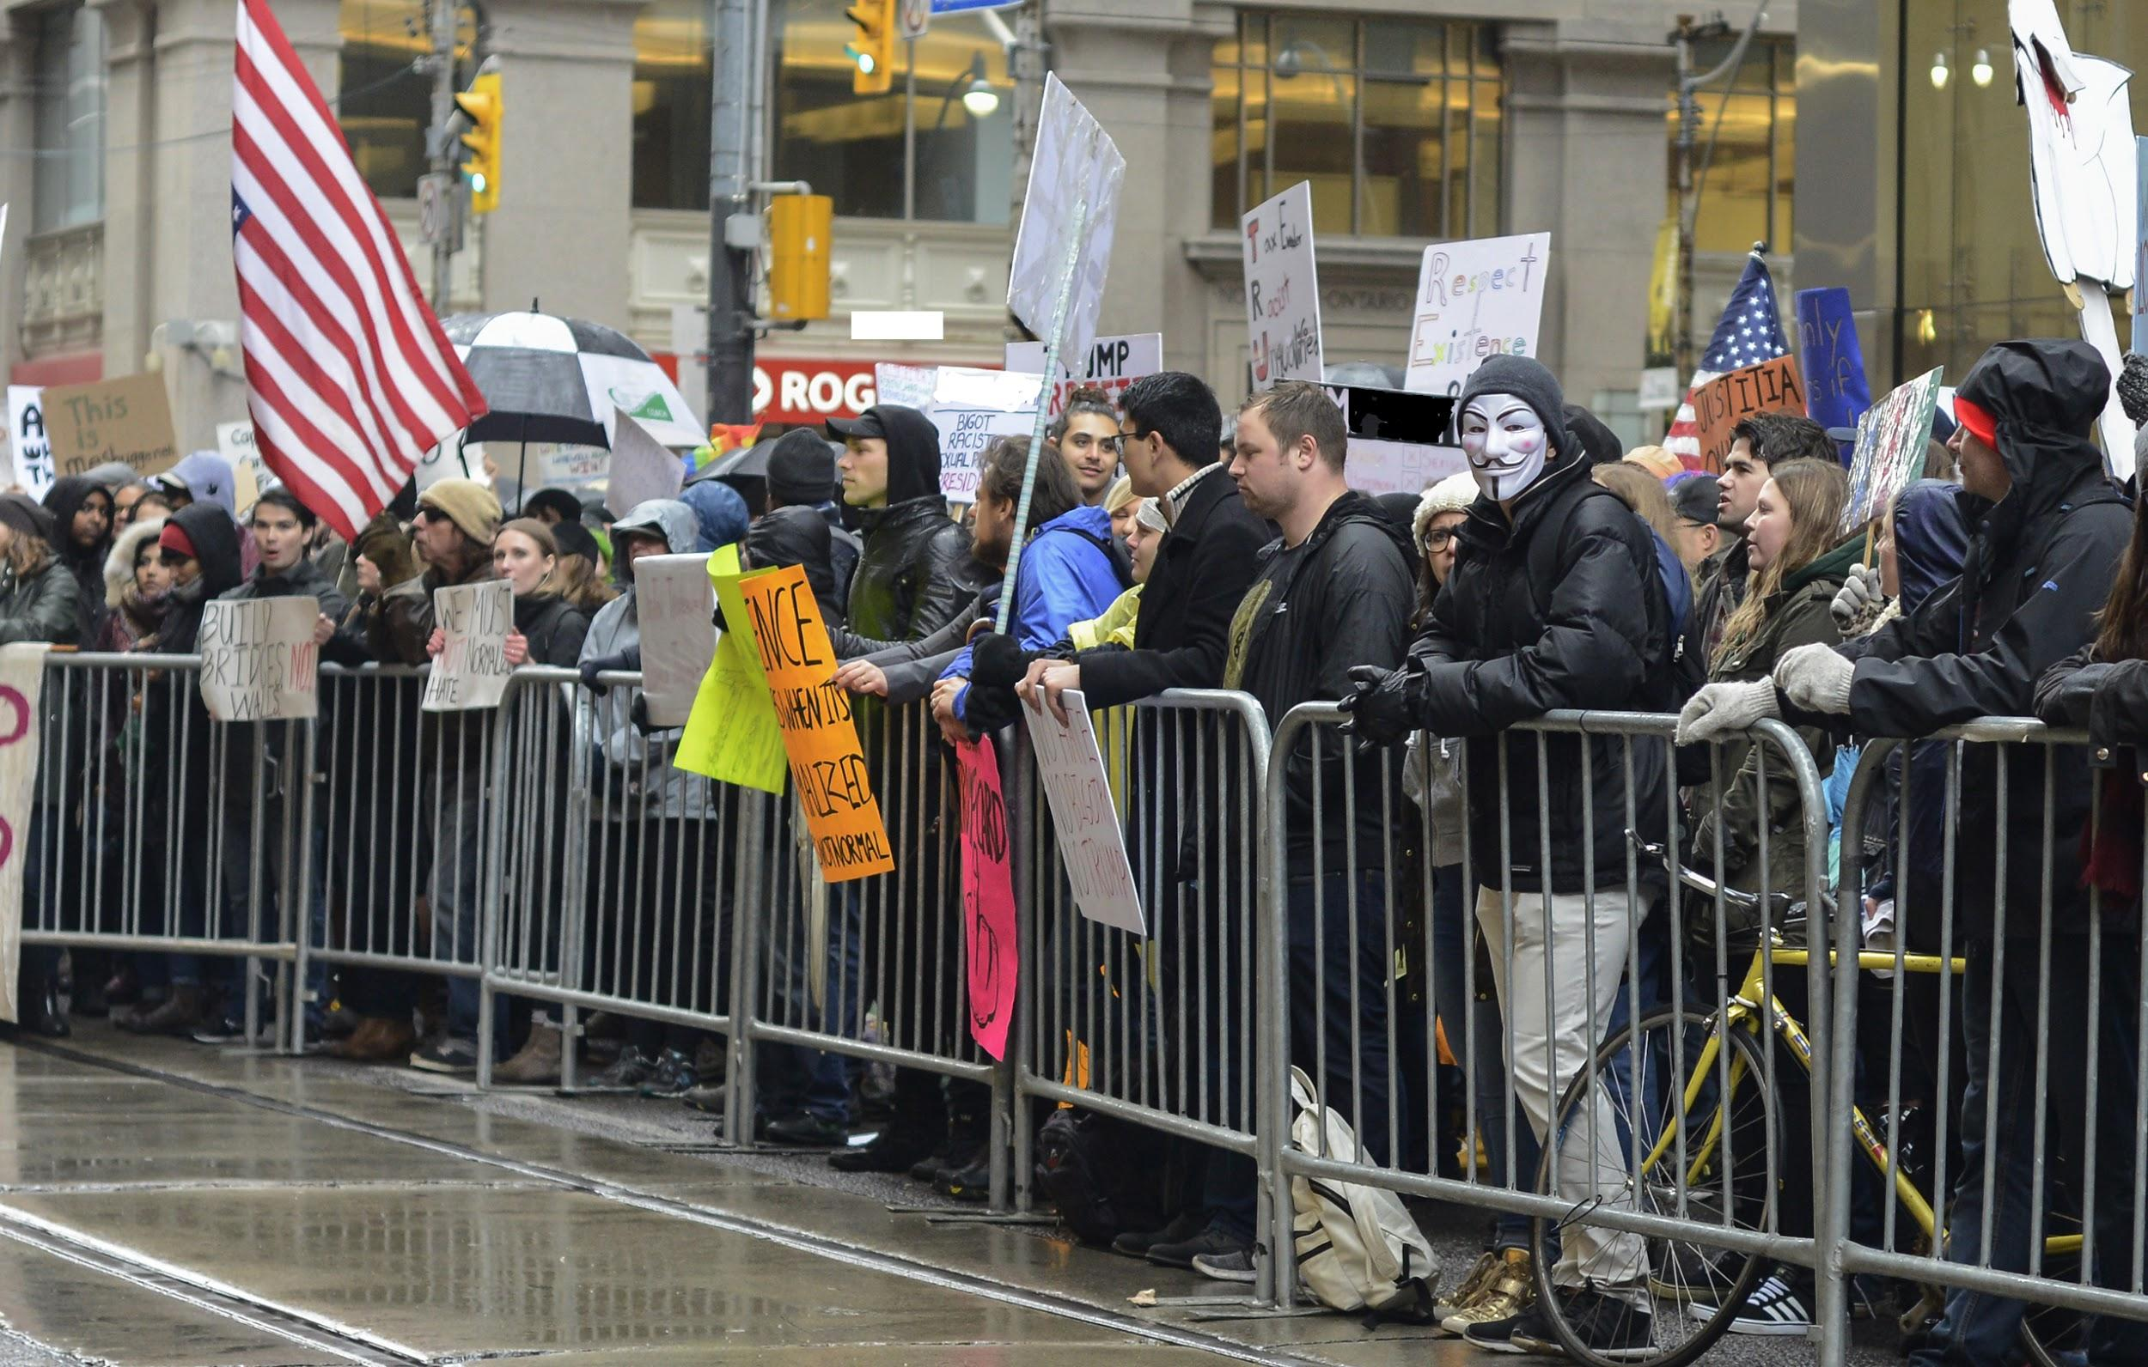
What are the legal limits?

Slide 8
Speech can be described as “protected” or “unprotected.”
Protected speech is protected by the First Amendment and cannot be restricted by the government.
Unprotected speech is not protected by the First Amendment and can be restricted by the government.

Slide 9
Unprotected speech
Incitement - Speech that spurs people to imminent, lawless action
“Let’s meet at the park to burn down that building tonight!”
Harassment - Repeatedly targeting an individual
True threats and intimidation - Must be real and credible
“I’m going to come to your house and beat you up this weekend.”
Obscenity
Defamation (Libel and slander)
Fraud, perjury, blackmail
Notes:
Generally, the legal standard for what constitutes unprotected speech is high. To be guilty of any of these crimes, there must be crystal clear evidence.
To be classified as obscenity, the work or expression must, taken as a whole, lack any serious literary, political, artistic, or scientific value to a reasonable person.
Libel is written defamation and slander is spoken defamation

Slide 10
Time, place, and manner restrictions
Courts have ruled that reasonable time, place, and manner limits may be imposed on speech, but authorities generally may not control the content of that speech.
This means limits on when, where and how you may exercise your free speech rights.
Private institutions are free to define their own rules, and some choose to limit speech and/or regulate protesting.
Notes:
Time, place, and manner restrictions legal limitations on when, where, and how free speech and protest rights are exercised

Slide 11
Limitations of legal protest
When protesting, you cannot…
Commit acts of violence
Harass or intimidate people
Use private property against the will of the owner
Make excessive noise
Cause unnecessary disruptions
Obstruct pathways and/or entrances or exits of buildings
Physically disrupt another protest
Call for violence
Vandalize
Commit other illegal acts

Slide 12
Limitations of legal protest
Don’t do anything that is already illegal when protesting.
Always consider the time, place, and manner when planning or participating in a protest.
Check local laws or university rules in case a permit or other considerations are required.

Slide 13
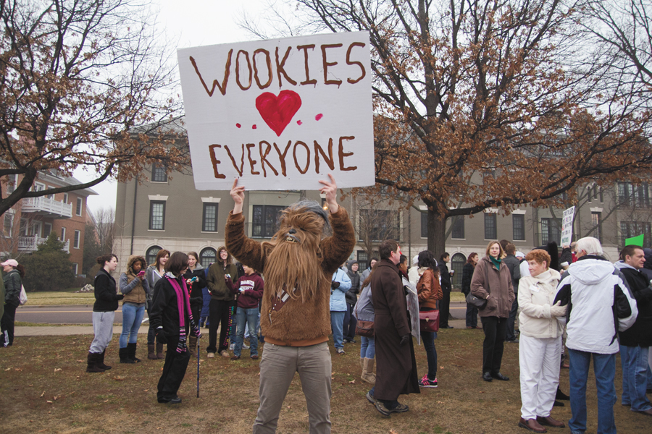
When exercising your right to protest, make sure you are doing so legally.

Slide 14
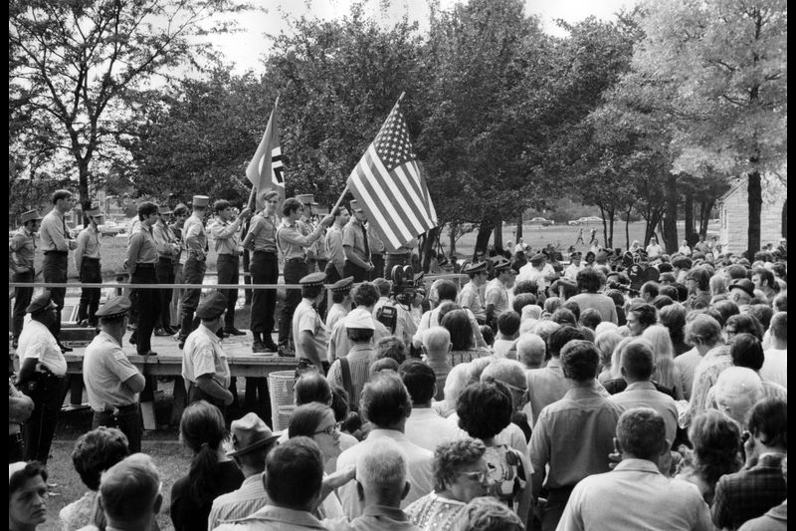
Controversial forms of protest: Offensive demonstrations
In 1978, a neo-Nazi group wanted to organize a march through Skokie, IL, a suburb of Chicago.
Many residents of the town were Holocaust survivors and were extremely offended by the group and their beliefs.
What factors would determine if the march would be legally allowed to happen?

Slide 15
Controversial forms of protest: Offensive demonstrations

Slide 16
Controversial forms of protest: Offensive demonstrations
The American Civil Liberties Union (ACLU) defended the constitutional rights of a group they strongly disagreed with.
The Illinois Supreme Court ruled in NSPA v. Skokie that the National Socialist Party of America could legally march through Skokie, Ill.
Protest permits cannot be denied due to the controversial nature of the message.
Notes:
NSPA v. Skokie

Slide 17
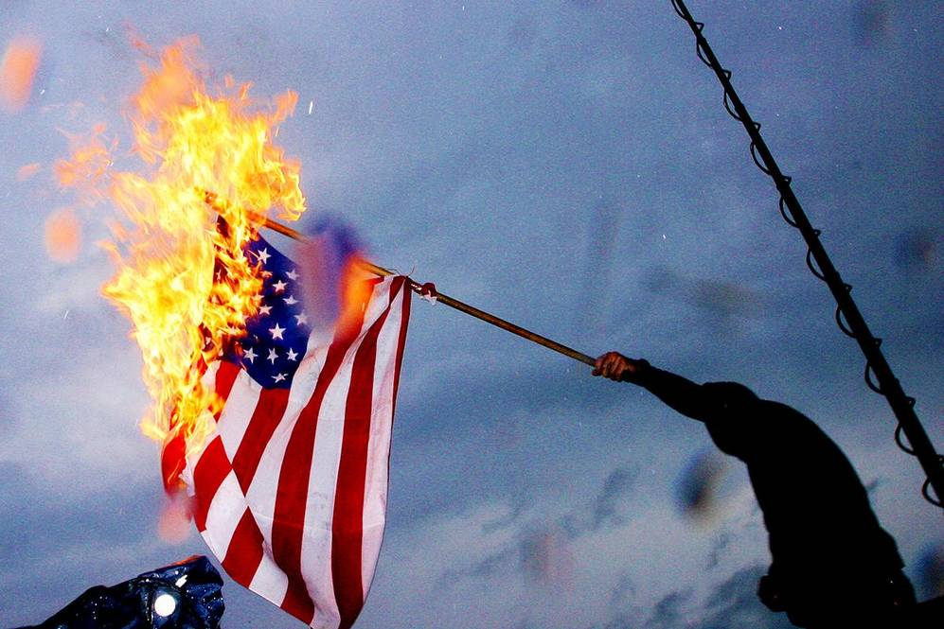
Controversial forms of protest: Flag burning
Is it legal to set the American flag on fire?
The U.S. Supreme Court have debated the legality of what people can and can’t do with the American flag as early as 1907.

Slide 18
Controversial forms of protest: Flag burning
Notes:
Texas v Johnson (1989)

Slide 19
Controversial forms of protest: Disrupting events
What does it mean to “shout down” someone?
There is no First Amendment right to shout down a speaker or disrupt an event.
Getting your message across should not violate someone else’s right to do the same.
Notes:
Also known as the Heckler’s Veto, no platforming, silencing

Slide 20
Controversial forms of protest: Disrupting events
Notes:
This is an example of shouting someone down or using The Heckler’s Veto.
“Shouting down” is the act of silencing someone with whom you disagree with by preventing them from being heard by shouting at them.
At 2:18, one of the disruptors says he is exercising his right to peaceably assemble. He demonstrates a clear misunderstanding of the First Amendment.
The audience member who says he is there to listen demonstrates how silencing others not only deprives the speaker’s right to free speech, but the listeners’ rights to hear what the speaker has to say. The philosophical aspect of this point is examined in John Stuart Mill’s “On Liberty.”

Slide 21
Key takeaways
Protesting is a right guaranteed to everyone in the United States by the First Amendment.
As long as the content of the speech is protected under the First Amendment, its legality depends on when, how and where the speech is communicated.
If you choose to organize or participate in a protest, make sure you understand how to do so legally.
Remember that all viewpoints have equal protection under the law. Other people are not legally allowed to disrupt your protest, just as you are not legally allowed to disrupt theirs.

